Slide 1


Slide 2
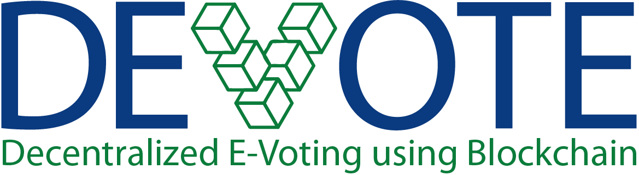

Slide 3



Muhammad Idrees (16CS78)
Saifullah Soomro (16CS94)
Mujeera Noor Thebo (16CS22)
Inamullah Memon (16CS76)
Mansoor Ahmed Jumani (16CS162)
Lead by Muhammad Waris(16CS44)
Supervisor : Dr. Moazzam Jawed

Slide 4


Slide 5






Prone to vote tampering
Time consuming method
of counting
Questionable results

Slide 6

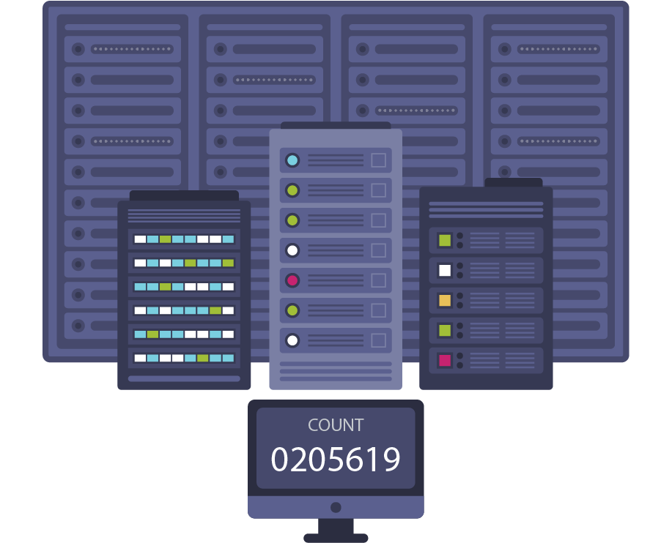
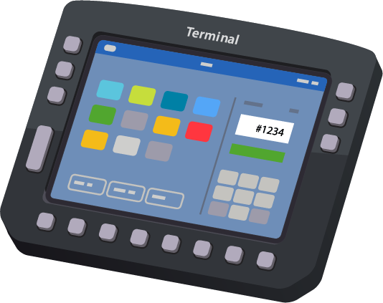
Voter authentication
Digitalized counting carried
out by a central server
Questionable results

Slide 7

The existing voting systems, whether conventional or electronic, involve insufficient levels of transparency since the election data is under control of a third party which makes it extremely difficult for voters to ensure that their election votes are counted carefully and accurately by the election administrators.

Slide 8


Slide 9
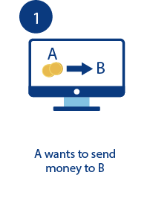
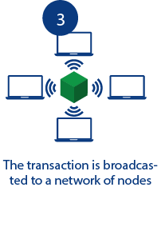
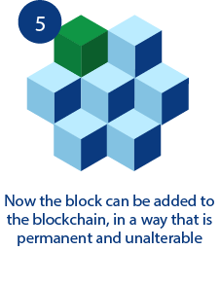


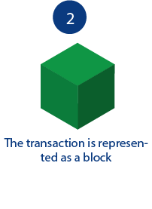
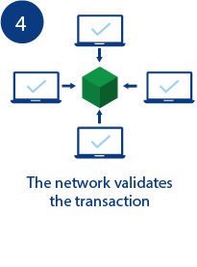
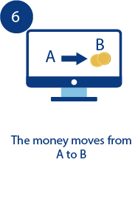

Slide 10


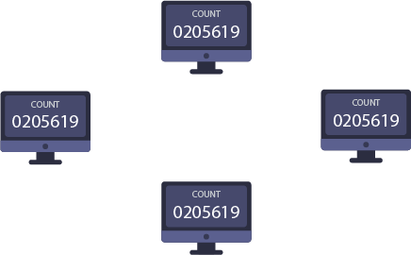
Voter authentication
Distributed ledger and
less counting time than
conventional voting
Trusted and publicly
verified results

Slide 11

References | Advantages | Limitations | Comments
General Elections, Pakistan, 2013 (Conventional) [1] | Paper Ballots were used which provide a verifiable paper trail | High risk of vote tampering and time consuming. | Election results can easily be manipulated.
Canada implemented E-voting in 2012 [2] | Faster than conventional voting system | Overload of server caused by Denial of Service attack | The government has access to the election data.
iVote implemented E-voting in Australia in 2015 [3] | Faster than conventional voting system and reliable server storage. | 66,000 votes were compromised due to cyber attack | The government has access to the election data.
Blockchain based E-Voting (not implemented yet) [4] | Publicly verifiable, secure, Voter identity protected, | Less throughput than centralized system. | Centralized system: 10,000/s Decentralized: 10 – 150 /s

Slide 12

Our aim is to develop a Decentralized E-Voting System using Blockchain for conducting elections
To develop such system that is tamper proof (no single entity has control over the election data)
Our objective is to develop such blockchain for our E-Voting system that can process a lot more transactions than the other blockchains (e.g. Bitcoin, Ethereum etc.)
To develop such system that provides a substantial level of transparency by sustaining an exposed registry of votes, while defending the privacy of the voters.

Slide 13

Use of a decentralized P2P network validates process of voting.
Voter Identity is secured using cryptographic hash (El Gamal / Paillier’s Cryptosystem)
Voter uses his/her private key to verify his/her ballot.
Consensus protocols used to add a new block to the chain (PoW/PoS/BFT)

Slide 15
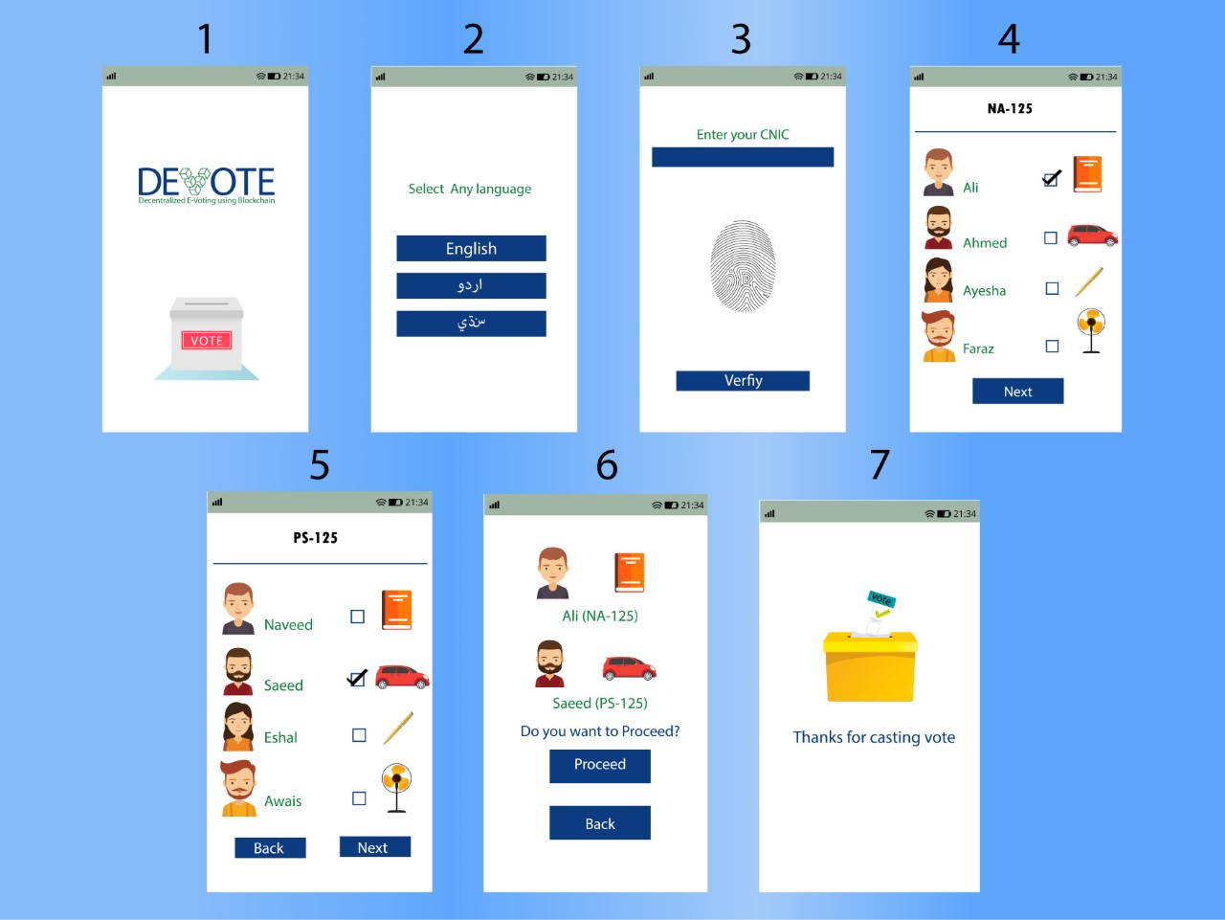
Application UI Design
1. Splash screen
2. Language selection screen
3. Voter verification screen
4. NA Candidate List
5. PS Candidate List
6. Confirmation screen
7. Acknowledgement screen.

Slide 16
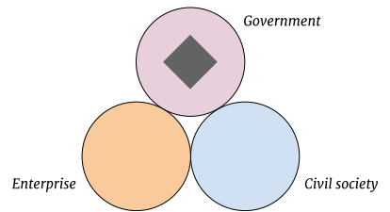
Black diamond represents E Voting infrastructure

Slide 17
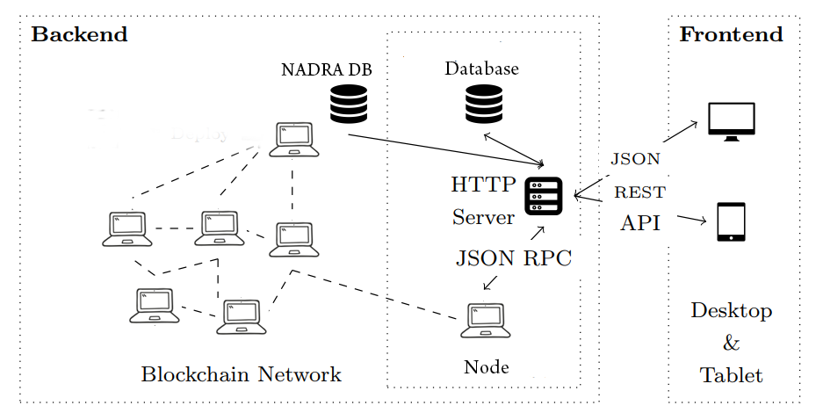
DE-VOTE Blockchain architecture

Slide 18
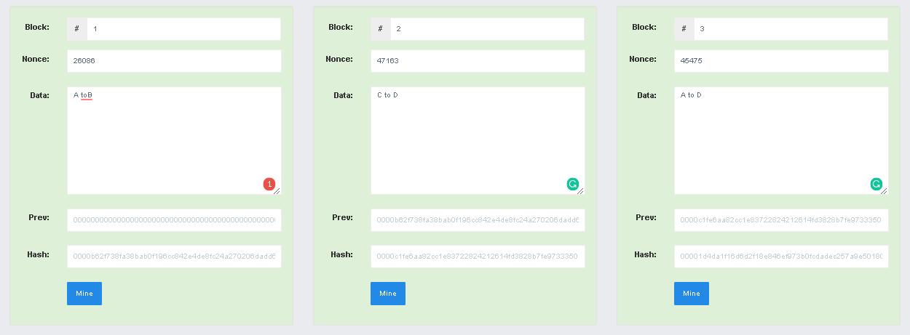
Blockchain implementation in a single node with PoW

Slide 19

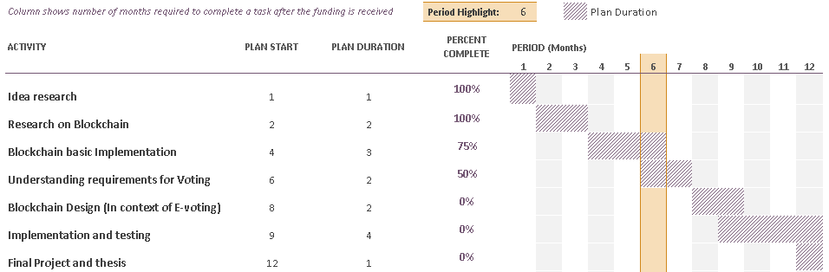

Slide 20

[1] K. Wüst, "Do you need a Blockchain?," in 2018 Crypto Valley Conference on Blockchain Technology, 2018.
[2] D. P. Moynihan, "Building Secure Elections: E‐Voting, Security, and Systems Theory," Public Administration Review, vol. 64, no. 5, pp. 515-528, 2004.
[3] A. M. A. HTET NE OO, "A Survey of Different Electronic Voting Systems," International Journal of Scientific Engineering and Technology Research, vol. 3, no. 16, pp. 3460-2464, 2014.
[4] B. R. Rifa Hanifatunnisa, "Blockchain Based E-Voting Recording System," in 11th International Conference on Telecommunication Systems Services and Applications (TSSA), Lombok, 2017.

Slide 21
[5] Mulcair handed NDP reins; Successor to Layton faces big challenges". Calgary Herald, March 25, 2012. [6] Michael Safi. "NSW election result could be challenged over iVote security flaw". The Guardian. Archived from the original on 2016-11-24. [7] B. Marr, "forbes.com," forbes, 16 02 2018. [Online]. Available: https://www.forbes.com/sites/bernardmarr/2018/02/16/a-very-brief-history-of- blockchain-technology-everyone-should-read/#6e81ced47bc4. [Accessed 04 12 2018]. [8] Agora, “agora.vote," Agora, 2018. [Online]. Available: https://agora.vote [Accessed 05 11 2018]. Illustration credits: FreePik.com

Slide 22


